Slide 1
Sorting in JAVA

Slide 2
Bubble Sort?
Bubble Sort is a simple sorting algorithm that repeatedly steps through the list, compares adjacent elements, and swaps them if they are in the wrong order.
Bubble Sort Algorithm (Step-by-Step):
Start from the first element (index 0).
Compare the current element with the next element.
If the current element is greater, swap them.
Move to the next element and repeat until the end.
Repeat the above steps for n-1 times, where n is the size of the array.
After each pass, the largest element "bubbles up" to the end.

Slide 3
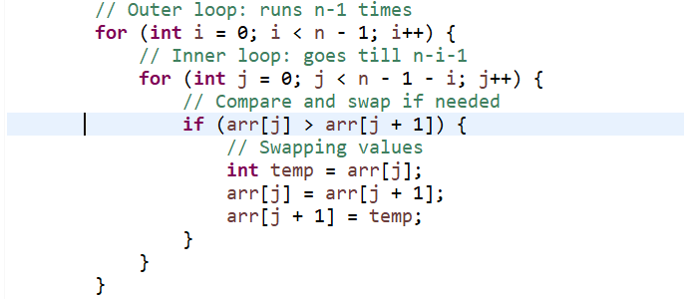
Algorithem
for i = 0 to n-1
for j = 0 to n-i-2
if array[j] > array[j+1]
swap array[j] and array[j+1]

Slide 4
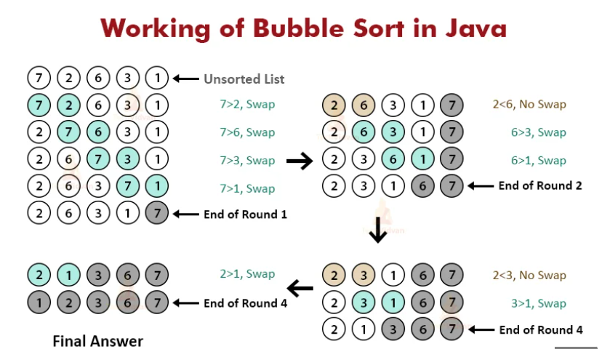

Slide 5
https://www.google.com/imgres?q=bubble%20sort%20in%20java&imgurl=https%3A%2F%2Ftechvidvan.com%2Ftutorials%2Fwp-content%2Fuploads%2Fsites%2F2%2F2020%2F06%2FWorking-of-Bubble-Sort-in-Java.jpg&imgrefurl=https%3A%2F%2Ftechvidvan.com%2Ftutorials%2Fjava-bubble-sort%2F&docid=7Fy5v_44YzvJ4M&tbnid=ALKFjR3U2RZA_M&vet=12ahUKEwi64IjOxaSOAxXS3jgGHd8QA2EQM3oECE4QAA..i&w=794&h=491&hcb=2&ved=2ahUKEwi64IjOxaSOAxXS3jgGHd8QA2EQM3oECE4QAA
Key Points:
Best case (already sorted): O(n)
Worst and average case: O(n²)
Bubble sort is not efficient for large datasets.
Simple and useful for teaching and understanding sorting basics.

Slide 6
Insertion Sort?
Insertion Sort is a simple sorting algorithm that builds the final sorted array one item at a time. Insertion Sort Algorithm (Step-by-Step):
Start with the second element (index 1), and compare it with the previous elements.
If it is smaller, shift the previous elements to the right.
Insert the element at the correct position.
Repeat for all elements in the array.
It is like sorting playing cards in your hands.
Stable sort (doesn’t change the order of equal elements).
Works well for small arrays or nearly sorted arrays.
Better than Bubble Sort in many cases.

Slide 7
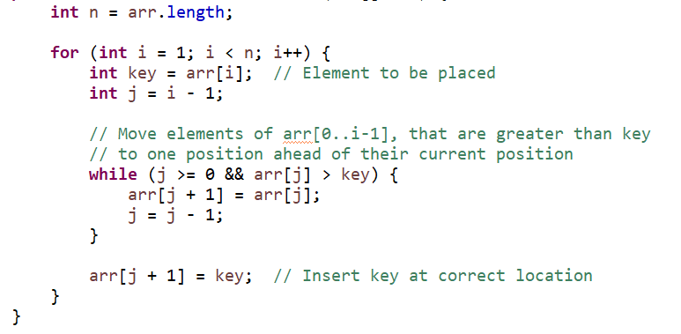
Alg
for i = 1 to n-1
key = array[i]
j = i - 1
while j >= 0 and array[j] > key
array[j + 1] = array[j]
j = j - 1
array[j + 1] = key
https://www.google.com/imgres?q=insertion%20sort%20in%20java&imgurl=https%3A%2F%2Fwww.w3resource.com%2Fw3r_images%2Finsertion-sort.png&imgrefurl=https%3A%2F%2Fwww.w3resource.com%2Fjava-exercises%2Fsorting%2Fjava-sorting-algorithm-exercise-7.php&docid=VmaX3FnhWQfAXM&tbnid=SH4X771zQO2jDM&vet=12ahUKEwjK74vDy6SOAxUToWMGHd8jFLwQM3oECBwQAA..i&w=862&h=543&hcb=2&ved=2ahUKEwjK74vDy6SOAxUToWMGHd8jFLwQM3oECBwQAA

Slide 8
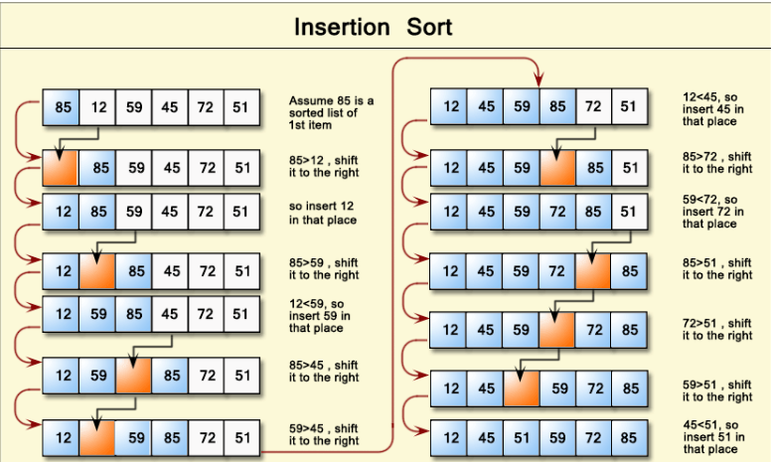

Slide 9
Selection Sort?
Selection Sort is a simple comparison-based sorting algorithm.
It selects the smallest (or largest) element from the unsorted part of the array and places it at the beginning. This process is repeated for the rest of the array.
Selection Sort Algorithm (Step-by-Step):
Start from index 0.
Find the smallest element in the unsorted part.
Swap it with the element at the current index.
Move to the next index and repeat until the array is sorted.
Always performs n(n−1)/2 comparisons, regardless of array state.
Not stable (may change order of equal elements).
Good for understanding basic sorting logic.

Slide 10
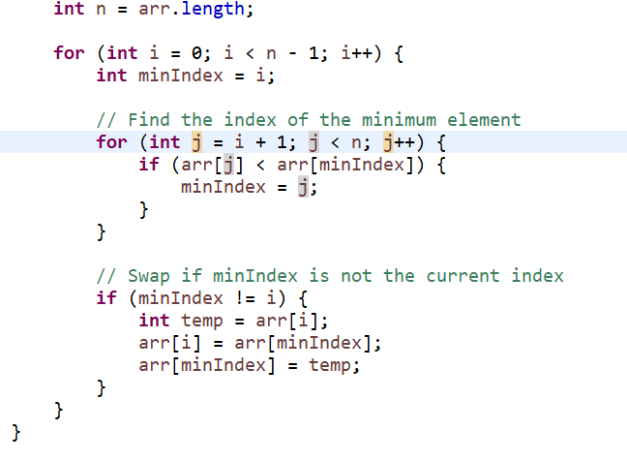
for i = 0 to n-1
minIndex = i
for j = i+1 to n-1
if array[j] < array[minIndex]
minIndex = j
swap array[i] and array[minIndex]

Slide 11
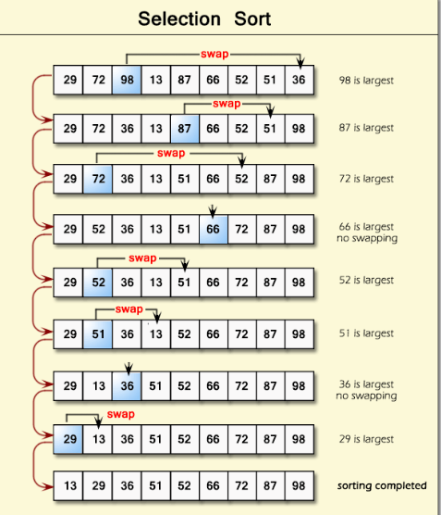
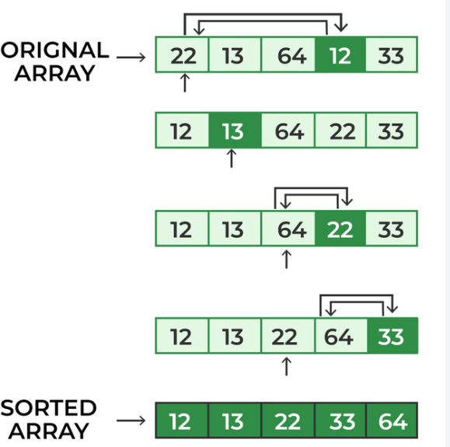

Slide 12
Quick sort ?
Quick Sort is a divide-and-conquer algorithm. It works by selecting a pivot element, and then partitioning the array into two parts:
Elements less than the pivot go to the left
Elements greater than the pivot go to the right
Recursively sort both parts
-----------------------
Quick Sort Algorithm (Step-by-Step):
Pick a pivot (usually the last element).
Partition the array:
Place pivot at correct sorted position.
Move smaller elements to the left, larger to the right.
Recursively apply the same steps to the subarrays.

Slide 13
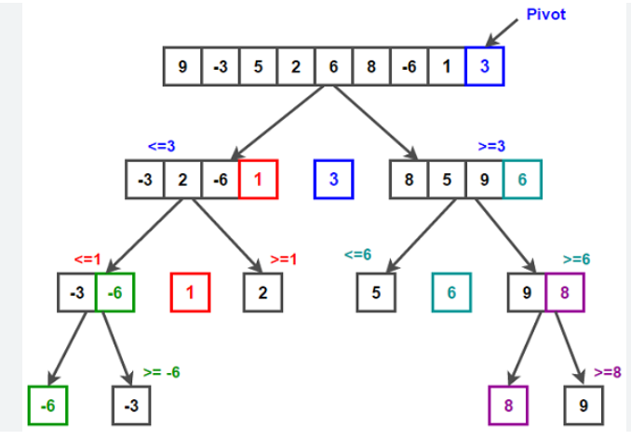
quickSort(arr, low, high):
if low < high:
pi = partition(arr, low, high)
quickSort(arr, low, pi - 1)
quickSort(arr, pi + 1, high)

Slide 14
Merge Sort?
Merge Sort is a divide-and-conquer algorithm. It:
Divides the array into two halves recursively.
Sorts each half.
Merges the two sorted halves into one sorted array.
----------------------
Merge Sort Algorithm Steps:
Divide the array into two halves.
Recursively sort the left half.
Recursively sort the right half.
Merge both sorted halves.

Slide 15
mergeSort(arr, left, right):
if left < right:
mid = (left + right) / 2
mergeSort(arr, left, mid)
mergeSort(arr, mid+1, right)
merge(arr, left, mid, right)

Slide 16
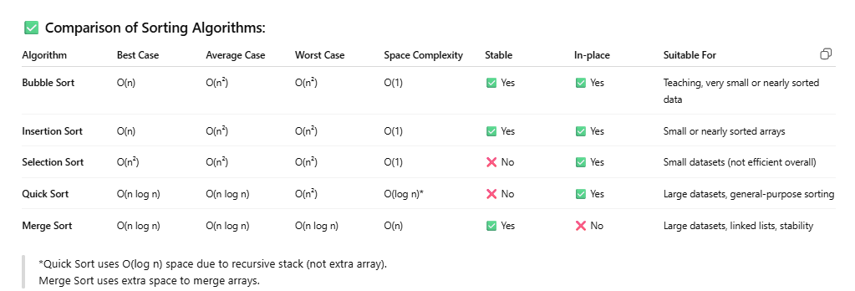

Slide 17
